Slide 1
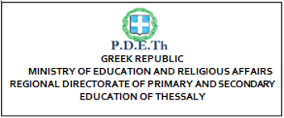
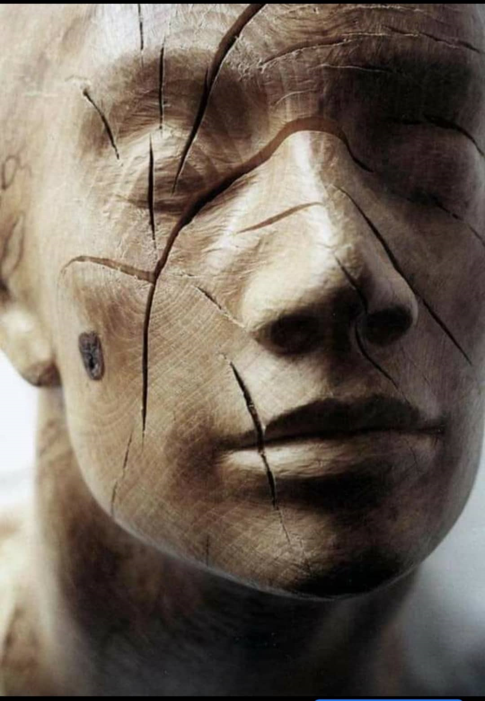
GUIDE ‘how to TRAIN THE TRAINER’
Regional Directorate
of Primary & Secondary Education
of Thessaly
Call 2020 Round 1 KA2 - Cooperation for innovation and the exchange of good practices
KA227 - Partnerships for Creativity
Form ID: KA227-B0766F27 (1.4.2020 – 28.02.2023)

Slide 2
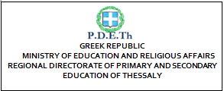
Table of Contents
INTRODUCTION: General aims of the “Train the Trainer” ABeyGA guidance
Developmental Characteristics of the focused age
Brief presentation of the Guide
1
Education in the Arts and Education through the Arts ………………………………..…………………….… PDETh
Ongoing (Lifelong) Learning in Arts ……………..………………………………………….. ESCOLA D’ ART D’ OLOT
Active Partnerships between Schools and Art’s organizations and between Teachers, Artists and the Community
………………………….………………………..…………. BLUE ROOOM INNOVATION
4. Emphasis on collaboration within Art Workshops …………………………..…………….……………….…… OPEN UP
5. Accessibility to all ………………………………………………… ……………….…….. INTEGRA ESCOLA JOAN XXIII
Shared responsibility for Planning, Implementation, Assessment Evaluation….... UNIVERSITY LUMIERE LYON 2
7. Detailed strategies for Assessing, Monitoring, Evaluating and Reporting ……….……………………………. COAT
Opportunities for Public Performance, Exhibition and/or Presentation ………………………….……………… PDETh
EPILOGUE

Slide 3
INTRODUCTION: GENERAL AIMS OF THE “TRAIN THE TRAINER” ABeyGA GUIDANCE
To design, offer and evaluate different activities/approaches/methods to art creations including some alternative and innovative ways to create art or to participate in
To involve all the senses
To utilize not only the school context but also the art workshops and all cultural environments such as museums, cultural centers, galleries, social work organizations, youth organizations etc.
To support art teachers, educators, youth trainers or youth workers in their process to organize art activities in the formal and non-formal environment as well as young learners (especially with SEND) increasing their abilities and encouraging at the same time their school and social inclusion
To develop the personal and professional development of the trainers so as to respond more efficiently to the demands of their social role, as parents, teachers, and professionals
To develop the learning skills and the empowerment of social- emotional abilities, self- expression and creativity of the young (especially with SEND) in order to be included in their social and cultural environment

Slide 4
Developmental Characteristics of the focused ages adolescents (middle school and high school students) and ERLY adults
1. The students of these ages might be thought of as both “late adolescents” and “young adults” (Skipper, 2005).
6. Adults seem best able to reconsider their personal beliefs and assumptions, if they have a place to be self- reflective, think critically and have a dialogue with trusted others (Merizow, 2000)
4. Mentors initially must work with the adolescents initial meaning – making balance and then challenge them at an appropriate time with an appropriate response being supportive to the adolescents’ “evolutionary passage,” or transformational change, brought on by the challenge (Kroger, 2004, p. 188).
2. They might be able to reflect critically on their own beliefs in addition to reflecting critically on the values of others (Mezirow, 2000)
5. In fact the central purpose of a college studio art education appears to be in furthering personal development (Bekkala, 1999; Madge & Weinbeger, 1973)
7. An imaginative response reflecting adult transformative learning is most often expressed trough language, but might also be presented as motion, color, texture, aesthetic or kinesthetic experiences for which language is unnecessary (Merizow, 2000)
3. By early adulthood individuals have a particular “frame-of-reference” from which they understand themselves and their relationship to the world (Mezirow, 2000).

Slide 5
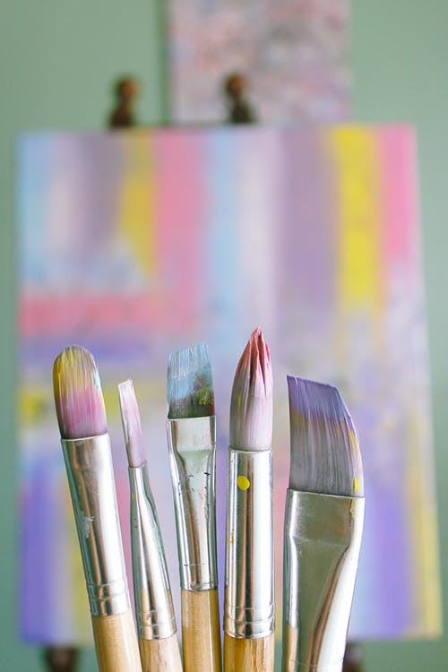
CHAPTER 1: EDUCATION IN THE ARTS and EDUCATION THROUGH THE ARTS (PDETh)
1.1. EDUCATION IN THE ART
1.1.a. What are the different kinds of Art that young people engage with in various learning environments e.g. Schools, Art galleries, Museums, e.t.c.: Drawing, Painting, Ceramics, Photography, Architecture, Sculpture, Craft, Printmaking, Design, Film making
1.1.b. Basic Art Materials Supply List: Paper, Pencils, Crayons, Markers, Modeling Material Chalk and Oil Pastels, Scissors, Glue, Paint & Brushes, Found Objects
1.1.c. Learning Objectives of Education in the Art and Developed Competences: Knowledge in different art topics, Cognitive abilities (SEND), Methods, materials, and techniques, Creativity, curiosity, imagination, initiative, critical thinking, problem solving skills and communication, Self-confidence and identity, Self expressing (SEND), Empathy cultivation (SEND)
1.1.d. Teaching Methods:
Making Connections through Drawing (between drawing and geometric shapes and measurements)
Changing the mistake
Nonverbal ways of communication (students with SEND)

Slide 6
CHAPTER 1 : EDUCATION IN THE ARTS and EDUCATION THROUGH THE ARTS
1. 2. EDUCATION THROUGH THE ARTS
1. 2.a. Learning Objectives of Education through Art and Developed Competences
Objectives: Combination of art and Education, Wholeness, Interdisciplinarity
Competences: Skills cultivation and development (critical thinking, language skills, expansion of Knowledge), Cognitive skills, Self-expression, Formulating students' own opinions
1. 2.b. Teaching Methods
Developing learning process: by making comparisons, viewing things from different perspectives, looking for ways to remember information and recalling information
Developing critical thinking: based on universal intellectual values that transcend subject matter divisions, such as clarity, accuracy, precision, consistency, relevance, sound evidence, good reasons, depth, breadth, and fairness
Cognitive Development: (Vygotsky) “thinking is [also] greatly influenced by instruction"

Slide 7
CHAPTER 2 : LIFELONG LEARNING IN ARTS (Escola D’ Art D’ Olot)
2.1. Introduction: Education doesn’t happen only within schools and universities
Art doesn’t happen only inside museums or at artists’ workshops
People interested in this field: learners, art students, people with general cultural or artístic interests, art professionals, specific universities for people over the age of 65, trainers, guides, communicators or artists
2.2. The chapter’s objectives:
multidimentional vision of LLLA
global view including digital technologies
provide trainers with an instrument
2.3. LLLA Definition:
according to H. B. Long (1985): inner personal process, even a basic need of human beings in order to deal with our environment, adapt and survive.
OCDE (2011) identifies three categories of learning forms:
- Formal
Non formal
Informal
So, LLLA is happening in all three levels of education allowing individuals to learn contents, abilities and competencies in a specific way and mostly outside formal education.

Slide 8
CHAPTER 2 : LIFELONG LEARNING IN ARTS (Escola D’ Art D’ Olot)
TO BE DEVELOPED (see template)
2.4. Worries about the importance of LLLA
2.5. Advantages/benefits of LLLA (eg. lifelong learning for a changing world …….)
2.6. The art as Creative Personal Realization (teachers, artists, youth as future citizens, community)
2.7. The art as Culture, History and Connectors
2.8. Arts as Means to Wellbeing
2.9. The Arts as Community Engagement

Slide 9
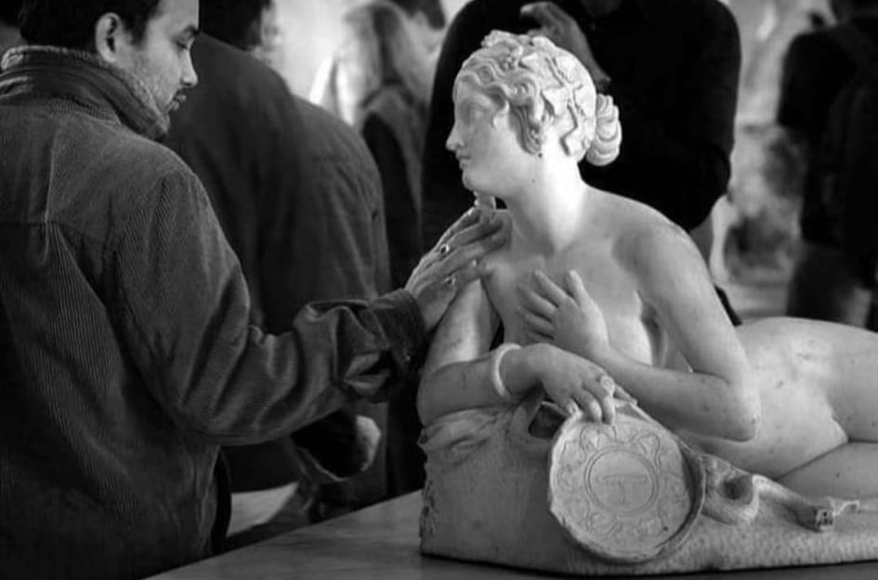
CHAPTER 3: ACTIVE PARTNERSHIPS BETWEEN SCHOOLS AND ART’S ORGANIZATIONS AND BETWEEN TEACHERS, ARTISTS AND THE COMMUNITY
(Blue Room Innovation)
3.1. Introduction: Definition of what Active Partnerships mean
3.2. Key considerations (Factors) for successful partnerships:
3.3. Different Types of Collaborative Activities (Theory):
3.3.a. Formal (school based) arts education environment: Ministries; Schools; Teachers (educators and artists); Arts; Science;
3.3.b. Informal (community based) arts education environment: Community organizations
e.g. Visiting art museums and galleries, Attending live performances, Invitation of Artists in School, Environmental Education through Arts Education, Organizing projects, Using new technologies in artistic creation, Online teaching Art, Emphasizing on Computer art, Collaboration between Subject Teachers at secondary school level
3.4. Good Practices Examples
3.4.a. In Formal arts education environment
3.4.b. And Informal arts education environment

Slide 10
CHAPTER 4: WAYS OF COLLABORATION (Open Up)
4. 1.a WAYS OF COLLABORATION in the School Environment of Secondary Education and Adults Education
Establishing procedures and expectations for collaborative work.
Assigning students to work in a variety of teams
Working on collaborative projects
Using the traditional way or computers and New Technology
Working on more complex tasks
Asking students open-ended questions
Helping them do relevant research
Finding resources and developing critical thinking
Using the interview technique
Making comment on one another’s blogs about in-process work
Using gallery walks
Learning via theater
Co-teaching, co-design, co-execution, co-debriefing, and co-reflection with local artists and community art organizations
Visiting performers or art exhibitions or theatres, field trips, participation in national arts events
4. 1.b. IMPACT (Personal & Professional Competences)
4. 1.c. IMPACT (School & Social Inclusion of youth with SEND)

Slide 11
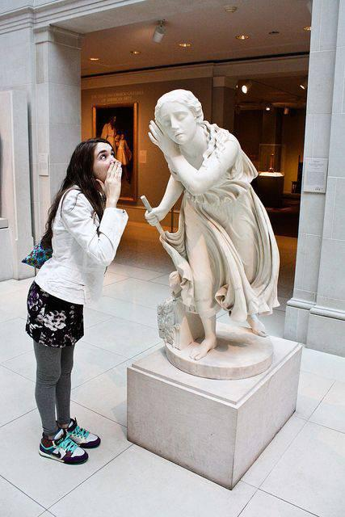
CHAPTER 4: WAYS OF COLLABORATION (Open Up)
4. 2.a. WAYS OF COLLABORATION in Art Workshops
improvisation
storytelling
brainstorming
problem solving
decision making
team building
4. 2.b. IMPACT (Personal & Professional Competences)
4. 2.c. IMPACT (School & Social Inclusion of youth with SEND)
4. 3.a. WAYS OF COLLABORATION in Youth Centers and Art Centers and their IMPACT (4. 3.b. & 4. 3.c.)
4. 4. a. WAYS OF COLLABORATION in Museums & their IMPACT (4.4.b. & 4.4.c.)
4. 5.a. WAYS OF COLLABORATION in Galleries & their IMPACT (4. 5.b. & 4. 5.c.)

Slide 12
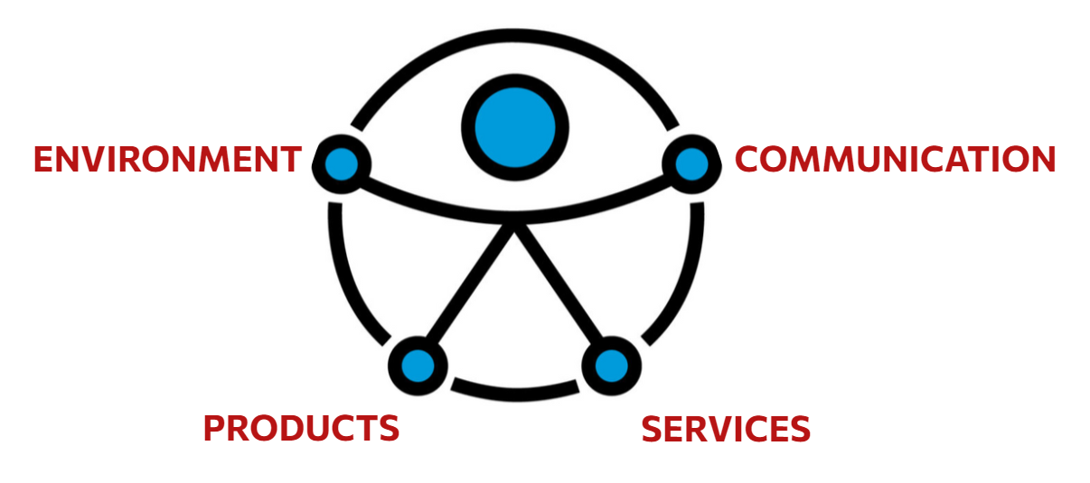
CHAPTER 5: ACCESSIBILITY TO ALL (Integra Escola Joan XXIII)
5.1. LEGAL AND REGULATORY FRAMEWORK IN ACCESSIBILITY (Historic context)
5.2 INCLUSION vs INTEGRATION: Inclusion aims to offer all people high expectations and opportunities in all areas of life, regardless of their characteristics, needs or disabilities and presupposes that the environments should be adapted to the diversity, while the aim of integration is to provide people with the necessary support so that they can participate in the environment.
5.3 ACCESSIBILITY: Universal accessibility is the condition that must be met by environments, processes, goods, products and services, as well as objects or instruments, tools and devices, in order to be comprehensible, usable and practicable by all people in conditions of safety, comfort and in the most natural and autonomous way possible.
5.3.1 UNIVERSAL DESIGN (Definition & 7 principles)
To Be Developed
5.3.2. FACTORS TO TAKE INTO ACCOUNT: ARCHITECTURE, MOBILITY
& DESIGN
5.3.3. DIGITAL FIELD
5.3.4. THE SENSES
5.3.5. INTELLECTUAL DIVERSITY
5.3.6. PRACTICES

Slide 13
CHAPTER 6: SHARED RESPONSIBILITY FOR PLANNING, IMPLEMENTATION, ASSESSMENT AND EVALUATION (University Lumiere Lyon 2)
6.1. Arts Education policies and their effectiveness (in children & adults)
Engaging with art is essential to the human experience: children communicate through artistic expression (Arts challenge us with different points of view, compel us to empathize with “others,” and give us the opportunity to reflect on the human condition). Among adults, arts participation is related to behaviors that contribute to the health of civil society, such as increased civil engagement, greater social tolerance, and reductions in other-regarding behavior.
6.1.a. In School level: “Art for art’s sake” has been insufficient for preserving the arts in schools
6.1.b. In national level: National surveys show that the arts are a necessary part of a well-rounded education
6.2. Descriptions of the nature and extent of current Arts Education programs (The case of schools in France)
The relationship between school and cultural practices is in many ways a paradoxical one.
Paradox 1. lies in the assumptions that are most often put forward to analyse the relationship between educational capital and cultural practices (hidden variable: the cultural capital transmitted by the family environment).
Paradox 2. is the relatively marginal status of the arts and culture within a school system that is nevertheless reputed to be one of the most humanities-oriented (imbalance 1 in favour of the literary field & Imbalance 2 between the field of heritage and that of contemporary creation)
Paradox 3. has to do with the contradictions of the massification of education (to reduce inequalities in cultural participation).

Slide 14
CHAPTER 6: SHARED RESPONSIBILITY FOR PLANNING, IMPLEMENTATION, ASSESSMENT AND EVALUATION (University Lumiere Lyon 2)
6.3. The diversity of methods for delivering Arts Education
Examples
«Katia à la chemise jaune »
“An anonymous face without features”
« Images reveal the skeleton of reality »
The Confluence Museum
To be developed
6.4. Evaluations of Arts Education programs and methods
6.5. Assessment of students ́ learning in Arts Education
6.6. The links between Arts Education and social abilities/active citizenship/empowerment
6.7. The influence of cultural industries (such as television and film) on children and other learners

Slide 15
CHAPTER 7: DETAILED STRATEGIES FOR ASSESSING, MONITORING, EVALUATING AND REPORTING (COAT)
7.1 ART ASSESSMENT
Governments and education policy makers are increasingly focused on the evaluation and assessment of students, teachers, school leaders, schools and education systems.
Assessment vs Evaluation
Assessment is a measurement of growth, is the process of collecting information about the progress and development of a student.
Evaluation is a judgment of mastery, ιt involves judgments about the quality, value, or worth of a response, product, or performance of a student based on established criteria.
Assessment in Art Education
“Doing” and “making” are critical components of arts education
Arts education assessment is authentic. In other words, it examines students’ work much like “real world” work is assessed.
An insistence on excellence
Judgment: Artwork should elicit a variety of responses
Importance of self-assessment
Multiple forms of assessment
Ongoing assessment
What should be assessed
Evaluator or evaluators
In the educational context there are many stakeholders who can legitimately contribute to the discourse about the quality of artwork made by students: the students themselves, the classroom teacher, the community of art teachers, arts administrators, and professional artists.

Slide 16
CHAPTER 7: DETAILED STRATEGIES FOR ASSESSING, MONITORING, EVALUATING AND REPORTING (COAT)
7.2 TYPES OF ASSESSMENT
Diagnostic
Formative
Summative
7.2.1 DIAGNOSTIC ASSESSMENT: to identify current knowledge and/or misconceptions about a topic
7.2.2 FORMATIVE ASSESSMENT: to provide feedback during the instructional process, allowing the teacher and student to chart progress and guide development. There are a variety of formative assessment tools available to teachers and students, including observation checklists, rubrics, and personal reflection prompts
-Tools of Formative Assessment
-Examples
7.2.3 SUMMATIVE ASSESSMENT: to sum up learning at the end of the instructional process
Characteristics of summative assessment
Types of summative assessment
Examples
7.3 METHODS & STRATEGY OF ASSESSMENT
7.3.1 PORTFOLIO ASSESSMENT
7.3.2 CURRICULUM
7.3.3 RUBRIC

Slide 17
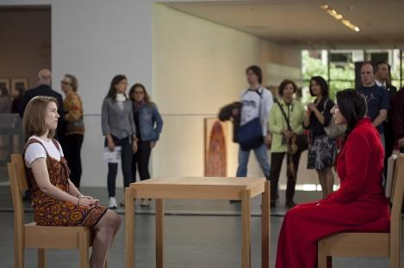
CHAPTER 8: OPPORTUNITIES FOR PUBLIC PERFORMANCE, EXHIBITION AND/OR PRESENTATION (PDETh)
INTRODUCTION: terms’ definition
2.1. MUSEUMS & GALLERIES
-Museums role in preserving, documenting and acquiring a performance
-The crucial role the audience plays in a performance
- In recent decades, there have been a range of political, social, and cultural pressures to museums to change, adapt, and modernize
2.2. ART WORKSHOPS IN EXHIBITION CENTERS
-Art Workshop’s objectives especially regarding SEND pupils (e.g. Foster spontaneous creativity of participants, internal and external realities are mixed into a new being, shape their character)
- Examples of Art Workshop
(In 2010 at MoMA, Abramović engaged in an extended performance called,
The Artist Is Present)

Slide 18
CHAPTER 8: OPPORTUNITIES FOR PUBLIC PERFORMANCE, EXHIBITION AND/OR PRESENTATION (PDETh)
2.3. SCHOOL PRESENTATIONS
Examples
2.4. ONLINE EXHIBITIONS & NATIONAL OR INTERNATIONAL PLATFORMS (DIGITAL – VIRTUAL EXHIBITIONS)
Virtual reality (VR) exhibitions
- Along with the physical environment, virtual environments have been used as a secondary environment or even as the main one.
- “Virtual reality is the creation of a virtual environment targeting our senses in such a way that we experience it as if we were there. And it uses a range of technologies to achieve this goal”.
- Online viewing rooms are planned and curated similar to a physical gallery space presenting exhibits in 3D.
- Websites with virtual reality application infrastructure

Slide 19
Thank you for your attention!

